Slide 1
EE2211 Tutorial 6
(remember to sign your attendance on the sheet of paper)

Slide 2
Lecture recap

Slide 3
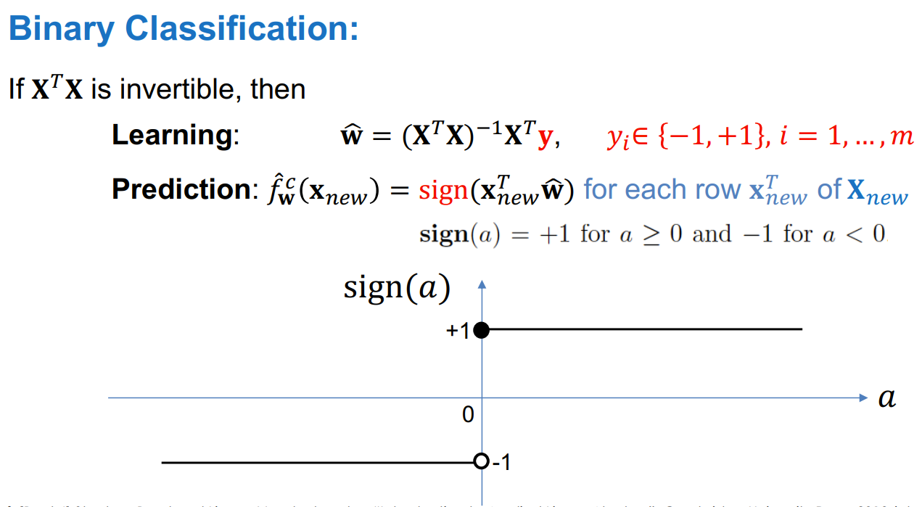
Linear regression

Slide 4
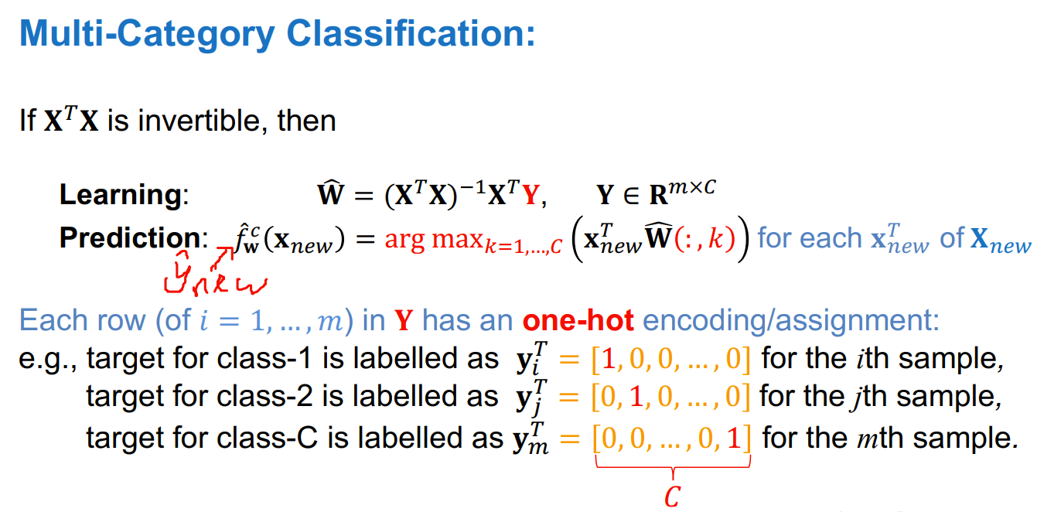
Linear regression

Slide 5
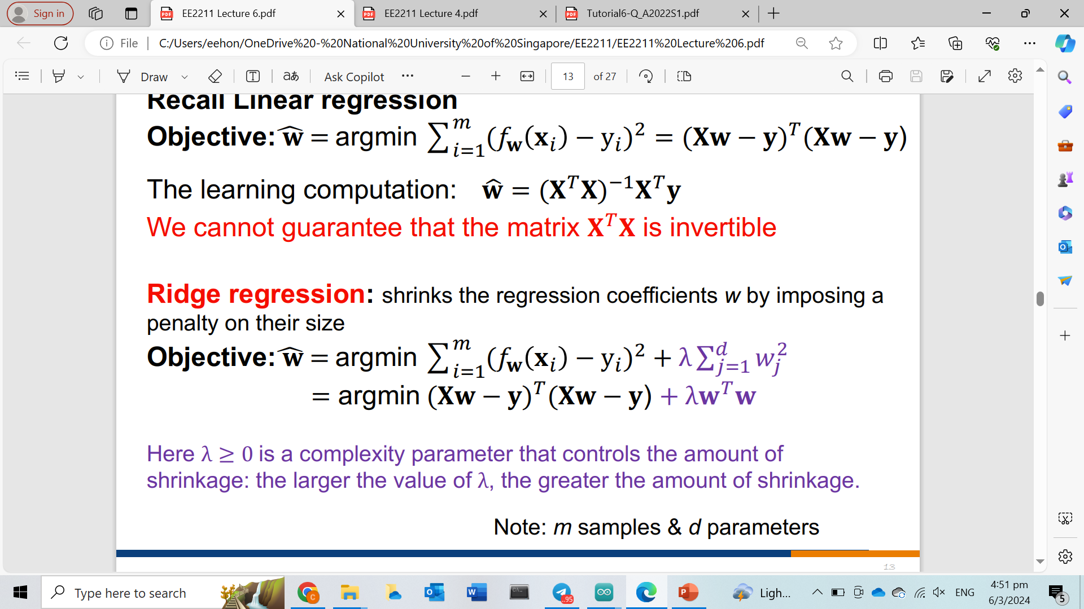
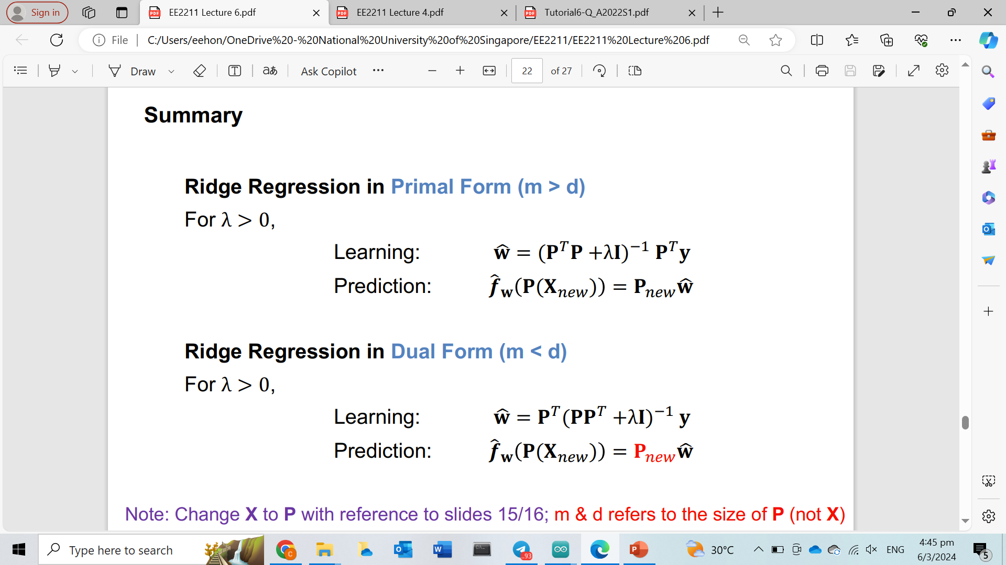
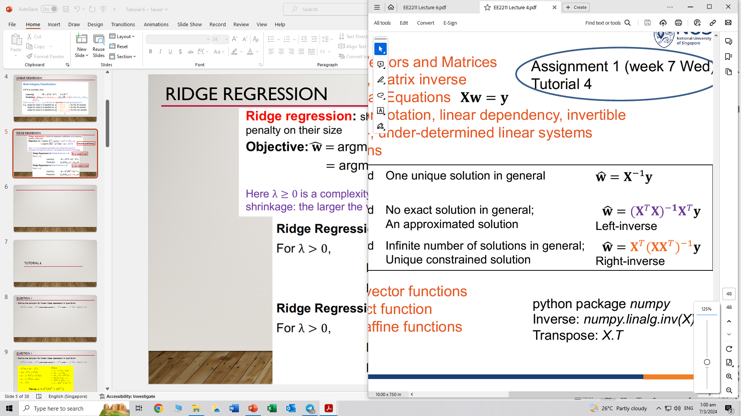
Ridge regression
Prevents overfitting!
Over-determined
Very similar!
Under-determined

Slide 6
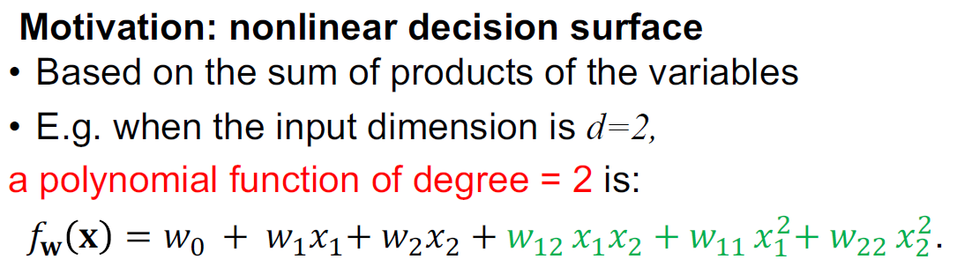
Polynomial regression

Slide 7
Tutorial 6

Slide 8
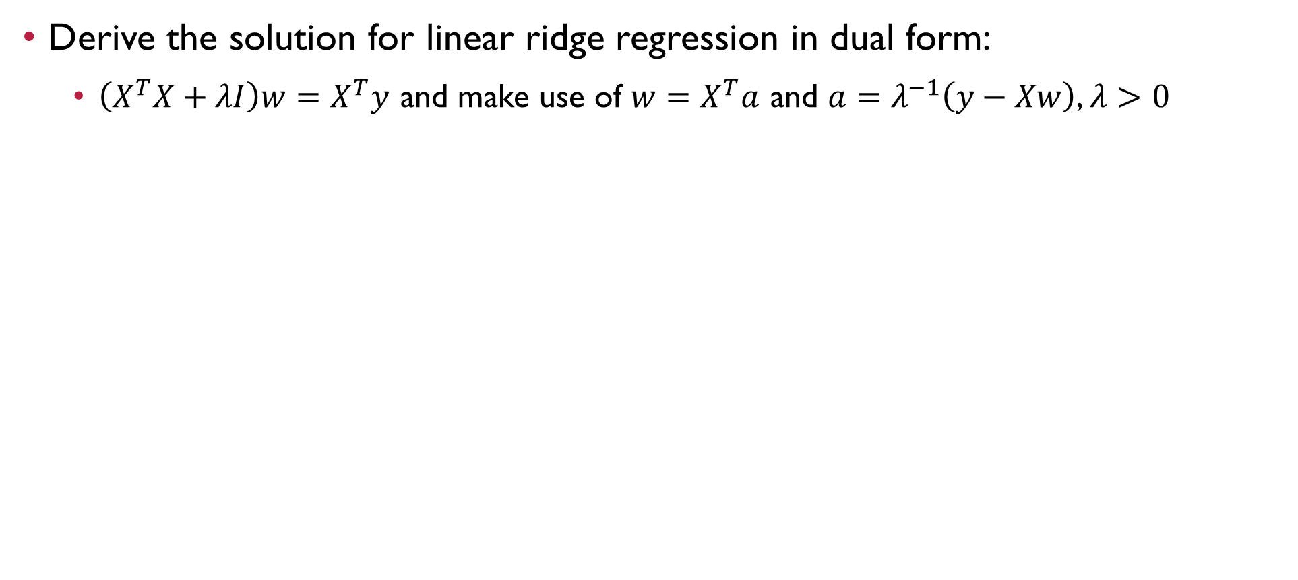
Question 1
Derive the solution for linear ridge regression in dual form:
$\left(X^{T}X+λI\right)w=X^{T}y$ and make use of $w=X^{T}a$ and $a=λ^{−1}\left(y−Xw\right)$, $λ>0$

Slide 9
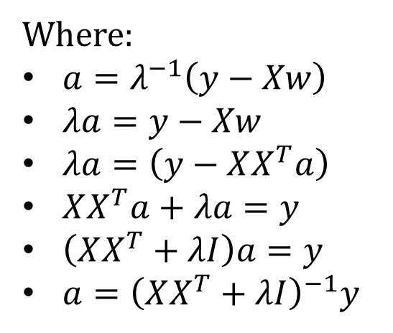
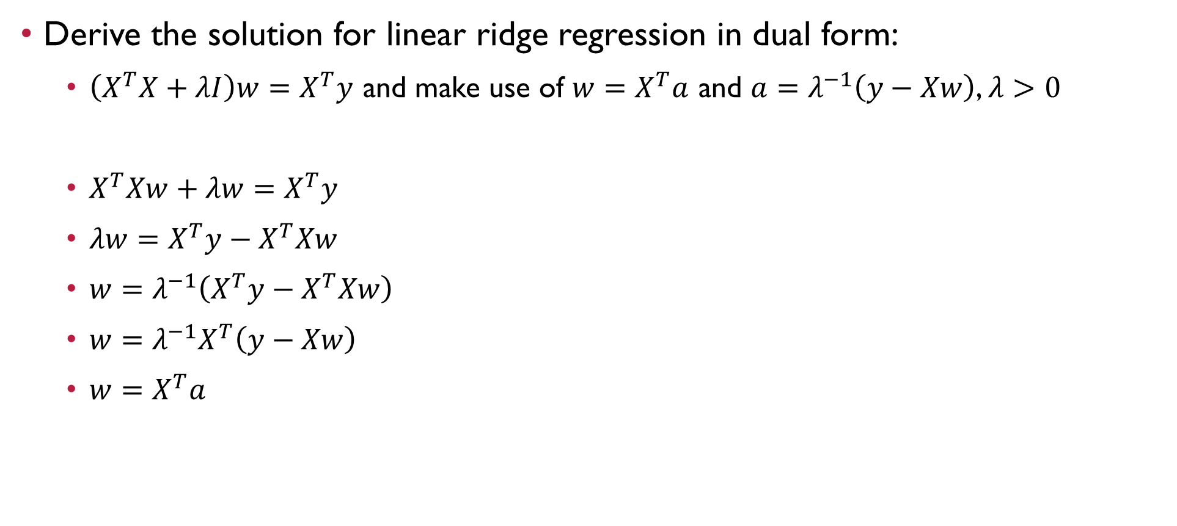

Question 1
Derive the solution for linear ridge regression in dual form:
$\left(X^{T}X+λI\right)w=X^{T}y$ and make use of $w=X^{T}a$ and $a=λ^{−1}\left(y−Xw\right)$, $λ>0$
$X^{T}Xw+λw=X^{T}y$
$λw=X^{T}y−X^{T}Xw$
$w=λ^{−1}\left(X^{T}y−X^{T}Xw\right)$
$w=λ^{−1}X^{T}\left(y−Xw\right)$
$w=X^{T}a$
Where:
$a=λ^{−1}\left(y−Xw\right)$
$λa=y−Xw$
$λa=\left(y−XX^{T}a\right)$
$XX^{T}a+λa=y$
$\left(XX^{T}+λI\right)a=y$
$a={\left(XX^{T}+λI\right)}^{−1}y$
Hence, $w=X^{T}{\left(XX^{T}+λI\right)}^{−1}y$

Slide 10
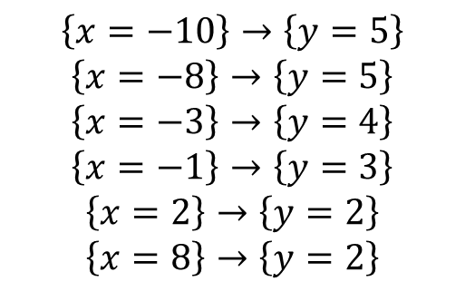
Question 2
Given the following data pairs for training:
Perform a 3rd-order polynomial regression and sketch the result of line fitting
$$\left\{x=−10\right\}→\left\{y=5\right\}$$
$$\left\{x=−8\right\}→\left\{y=5\right\}$$
$$\left\{x=−3\right\}→\left\{y=4\right\}$$
$$\left\{x=−1\right\}→\left\{y=3\right\}$$
$$\left\{x=2\right\}→\left\{y=2\right\}$$
$$\left\{x=8\right\}→\left\{y=2\right\}$$

Slide 11
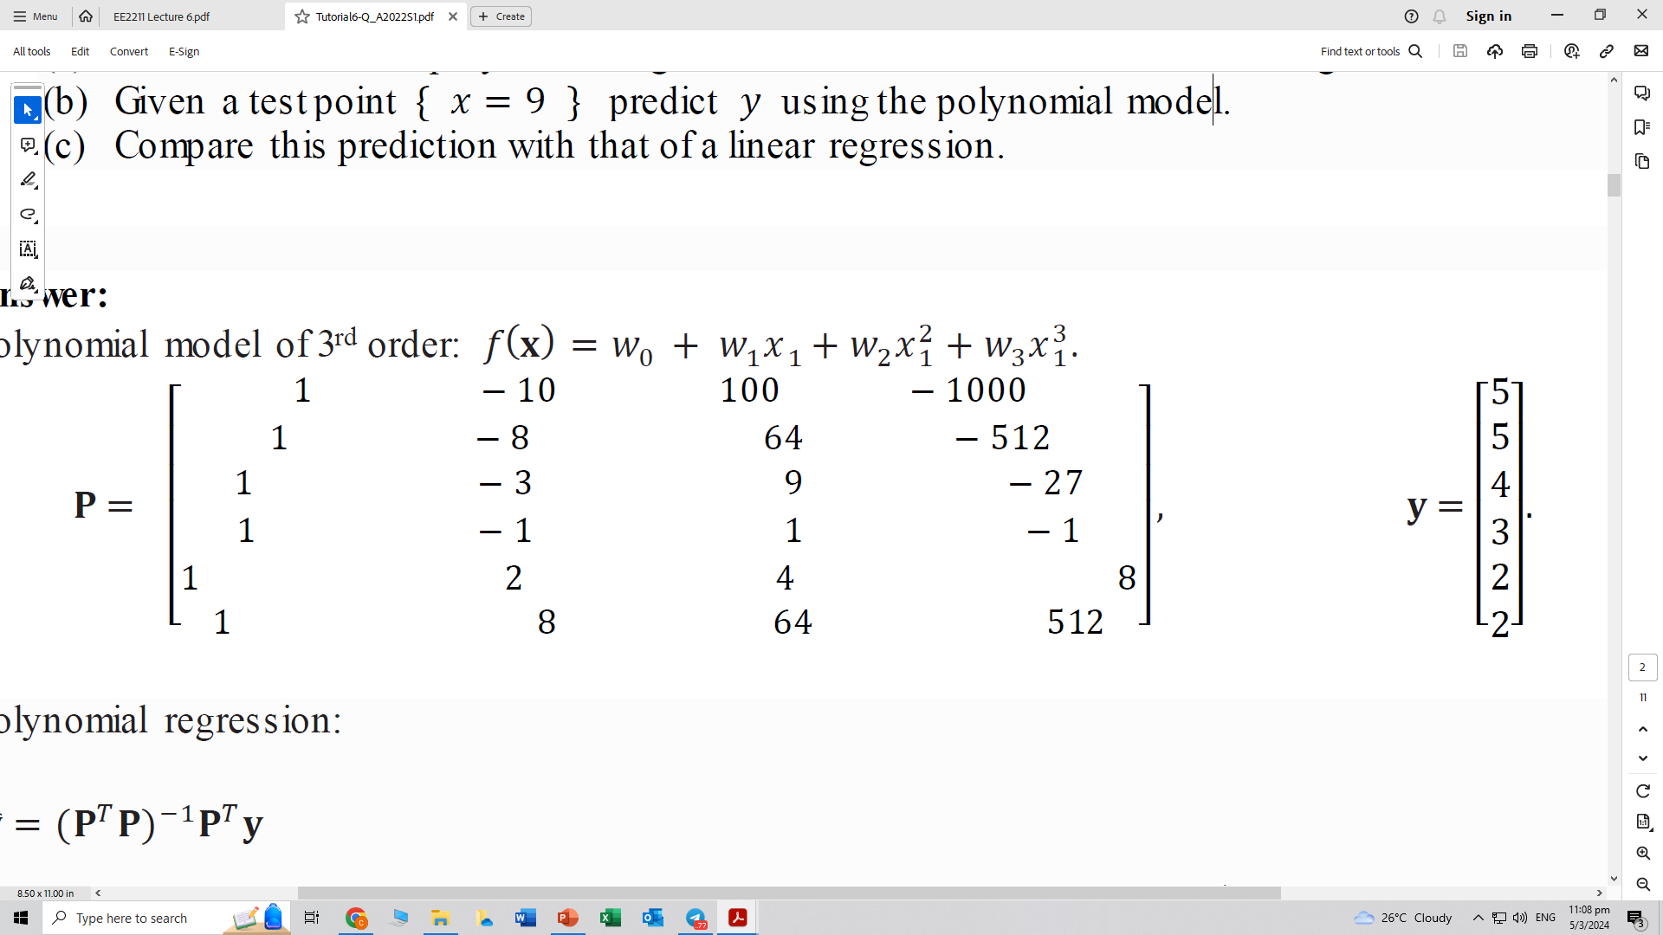
Question 2
Given the following data pairs for training:
Perform a 3rd-order polynomial regression and sketch the result of line fitting
$$\left\{x=−10\right\}→\left\{y=5\right\}$$
$$\left\{x=−8\right\}→\left\{y=5\right\}$$
$$\left\{x=−3\right\}→\left\{y=4\right\}$$
$$\left\{x=−1\right\}→\left\{y=3\right\}$$
$$\left\{x=2\right\}→\left\{y=2\right\}$$
$$\left\{x=8\right\}→\left\{y=2\right\}$$
Polynomial model of 3rd order: $f\left(x\right)=w_{0}+w_{1}x_{1}+w_{2}x_{1}^{2}+w_{3}x_{1}^{3}$

Slide 12
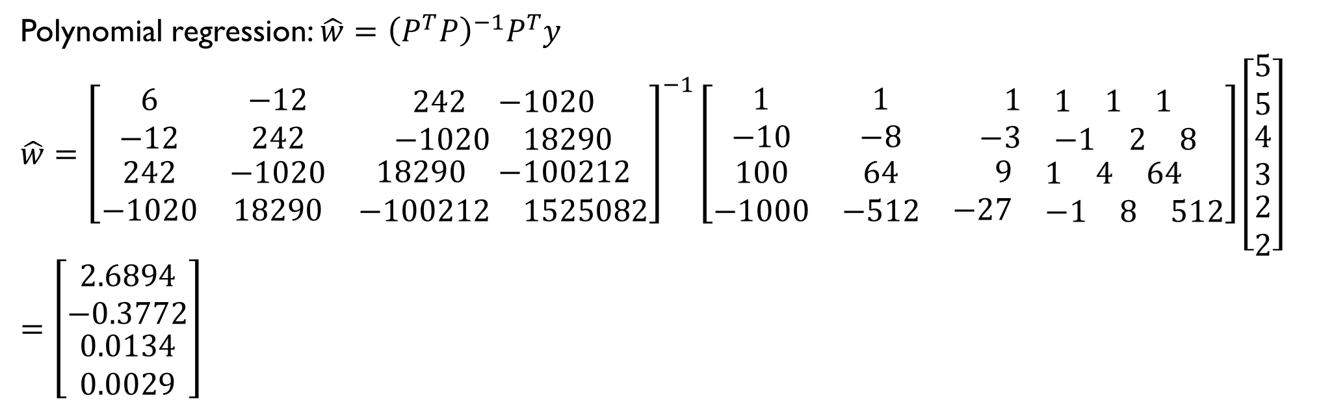
Question 2
Given the following data pairs for training:
Perform a 3rd-order polynomial regression and sketch the result of line fitting
$$\left\{x=−10\right\}→\left\{y=5\right\}$$
$$\left\{x=−8\right\}→\left\{y=5\right\}$$
$$\left\{x=−3\right\}→\left\{y=4\right\}$$
$$\left\{x=−1\right\}→\left\{y=3\right\}$$
$$\left\{x=2\right\}→\left\{y=2\right\}$$
$$\left\{x=8\right\}→\left\{y=2\right\}$$
Polynomial regression: $\hat{w}={\left(P^{T}P\right)}^{−1}P^{T}y$
$$\hat{w}={\left[\begin{matrix}6 & −12 & \begin{matrix}242 & −1020\end{matrix} \\ −12 & 242 & \begin{matrix}−1020 & 18290\end{matrix} \\ \begin{matrix}242 \\ −1020\end{matrix} & \begin{matrix}−1020 \\ 18290\end{matrix} & \begin{matrix}\begin{matrix}18290 & −100212\end{matrix} \\ \begin{matrix}−100212 & 1525082\end{matrix}\end{matrix}\end{matrix}\right]}^{−1}\left[\begin{matrix}1 & 1 & \begin{matrix}1 & \begin{matrix}1 & 1 & 1\end{matrix}\end{matrix} \\ −10 & −8 & \begin{matrix}−3 & \begin{matrix}−1 & 2 & 8\end{matrix}\end{matrix} \\ \begin{matrix}100 \\ −1000\end{matrix} & \begin{matrix}64 \\ −512\end{matrix} & \begin{matrix}\begin{matrix}9 & \begin{matrix}1 & 4 & 64\end{matrix}\end{matrix} \\ \begin{matrix}−27 & \begin{matrix}−1 & 8 & 512\end{matrix}\end{matrix}\end{matrix}\end{matrix}\right]\left[\begin{matrix}5 \\ 5 \\ \begin{matrix}4 \\ 3 \\ \begin{matrix}2 \\ 2\end{matrix}\end{matrix}\end{matrix}\right]$$
$$=\left[\begin{matrix}2.6894 \\ −0.3772 \\ \begin{matrix}0.0134 \\ 0.0029\end{matrix}\end{matrix}\right]$$

Slide 13
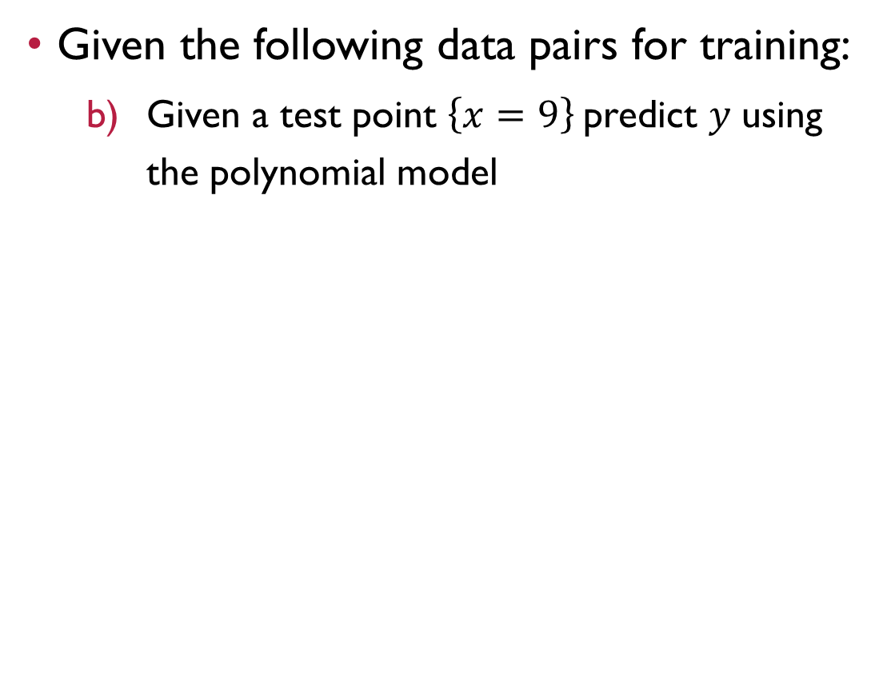
Question 2
Given the following data pairs for training:
Given a test point $\left\{x=9\right\}$predict 𝑦 using the polynomial model
$$\left\{x=−10\right\}→\left\{y=5\right\}$$
$$\left\{x=−8\right\}→\left\{y=5\right\}$$
$$\left\{x=−3\right\}→\left\{y=4\right\}$$
$$\left\{x=−1\right\}→\left\{y=3\right\}$$
$$\left\{x=2\right\}→\left\{y=2\right\}$$
$$\left\{x=8\right\}→\left\{y=2\right\}$$

Slide 14
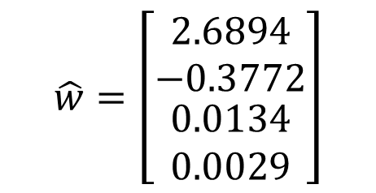
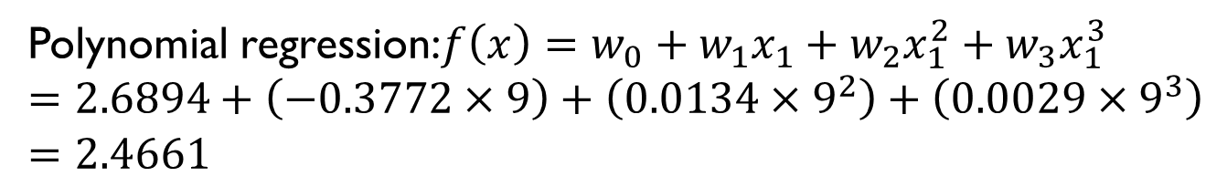
Question 2
Given the following data pairs for training:
Given a test point $\left\{x=9\right\}$predict 𝑦 using the polynomial model
$$\left\{x=−10\right\}→\left\{y=5\right\}$$
$$\left\{x=−8\right\}→\left\{y=5\right\}$$
$$\left\{x=−3\right\}→\left\{y=4\right\}$$
$$\left\{x=−1\right\}→\left\{y=3\right\}$$
$$\left\{x=2\right\}→\left\{y=2\right\}$$
$$\left\{x=8\right\}→\left\{y=2\right\}$$
Polynomial regression:$f\left(x\right)=w_{0}+w_{1}x_{1}+w_{2}x_{1}^{2}+w_{3}x_{1}^{3}$
$$=2.6894+\left(−0.3772×9\right)+\left(0.0134×9^{2}\right)+\left(0.0029×9^{3}\right)$$
$$=\text{2.4661}$$
$$\hat{w}=\left[\begin{matrix}2.6894 \\ −0.3772 \\ \begin{matrix}0.0134 \\ 0.0029\end{matrix}\end{matrix}\right]$$

Slide 15
Question 2
Given the following data pairs for training:
Compare this prediction with that of a linear regression
$$\left\{x=−10\right\}→\left\{y=5\right\}$$
$$\left\{x=−8\right\}→\left\{y=5\right\}$$
$$\left\{x=−3\right\}→\left\{y=4\right\}$$
$$\left\{x=−1\right\}→\left\{y=3\right\}$$
$$\left\{x=2\right\}→\left\{y=2\right\}$$
$$\left\{x=8\right\}→\left\{y=2\right\}$$

Slide 16
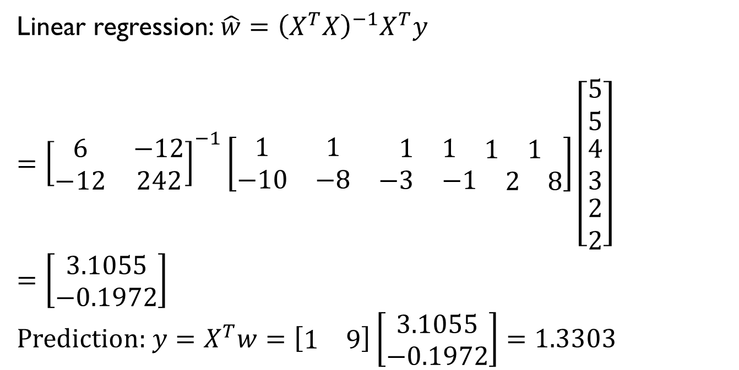
Question 2
Given the following data pairs for training:
Compare this prediction with that of a linear regression
$$\left\{x=−10\right\}→\left\{y=5\right\}$$
$$\left\{x=−8\right\}→\left\{y=5\right\}$$
$$\left\{x=−3\right\}→\left\{y=4\right\}$$
$$\left\{x=−1\right\}→\left\{y=3\right\}$$
$$\left\{x=2\right\}→\left\{y=2\right\}$$
$$\left\{x=8\right\}→\left\{y=2\right\}$$
Linear regression:$\hat{w}={\left(X^{T}X\right)}^{−1}X^{T}y$
$$={\left[\begin{matrix}6 & −12 \\ −12 & 242\end{matrix}\right]}^{−1}\left[\begin{matrix}1 & 1 & \begin{matrix}1 & 1 & \begin{matrix}1 & 1\end{matrix}\end{matrix} \\ −10 & −8 & \begin{matrix}−3 & −1 & \begin{matrix}2 & 8\end{matrix}\end{matrix}\end{matrix}\right]\left[\begin{matrix}5 \\ 5 \\ \begin{matrix}4 \\ 3 \\ \begin{matrix}2 \\ 2\end{matrix}\end{matrix}\end{matrix}\right]$$
$$=\left[\begin{matrix}3.1055 \\ −0.1972\end{matrix}\right]$$
Prediction: $y=X^{T}w=\left[\begin{matrix}1 & 9\end{matrix}\right]\left[\begin{matrix}3.1055 \\ −0.1972\end{matrix}\right]=1.3303$

Slide 17
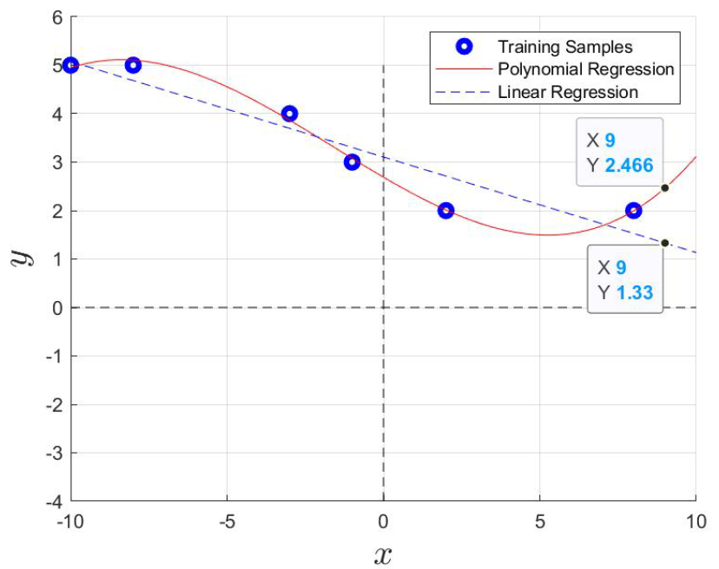
Question 2
Given the following data pairs for training:
Compare this prediction with that of a linear regression
$$\left\{x=−10\right\}→\left\{y=5\right\}$$
$$\left\{x=−8\right\}→\left\{y=5\right\}$$
$$\left\{x=−3\right\}→\left\{y=4\right\}$$
$$\left\{x=−1\right\}→\left\{y=3\right\}$$
$$\left\{x=2\right\}→\left\{y=2\right\}$$
$$\left\{x=8\right\}→\left\{y=2\right\}$$

Slide 18
Question 3
Write down the expression for a 3rd order polynomial model having a 3-dimensional input

Slide 19
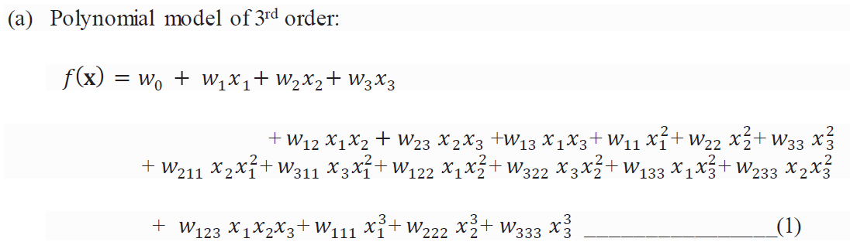
Question 3
Write down the expression for a 3rd order polynomial model having a 3-dimensional input

Slide 20
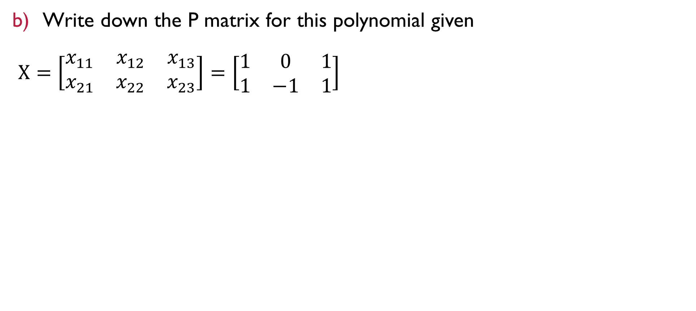
Question 3
Write down the P matrix for this polynomial given
$X=\left[\begin{matrix}x_{11} & x_{12} & x_{13} \\ x_{21} & x_{22} & x_{23}\end{matrix}\right]=\left[\begin{matrix}1 & 0 & 1 \\ 1 & −1 & 1\end{matrix}\right]$

Slide 21
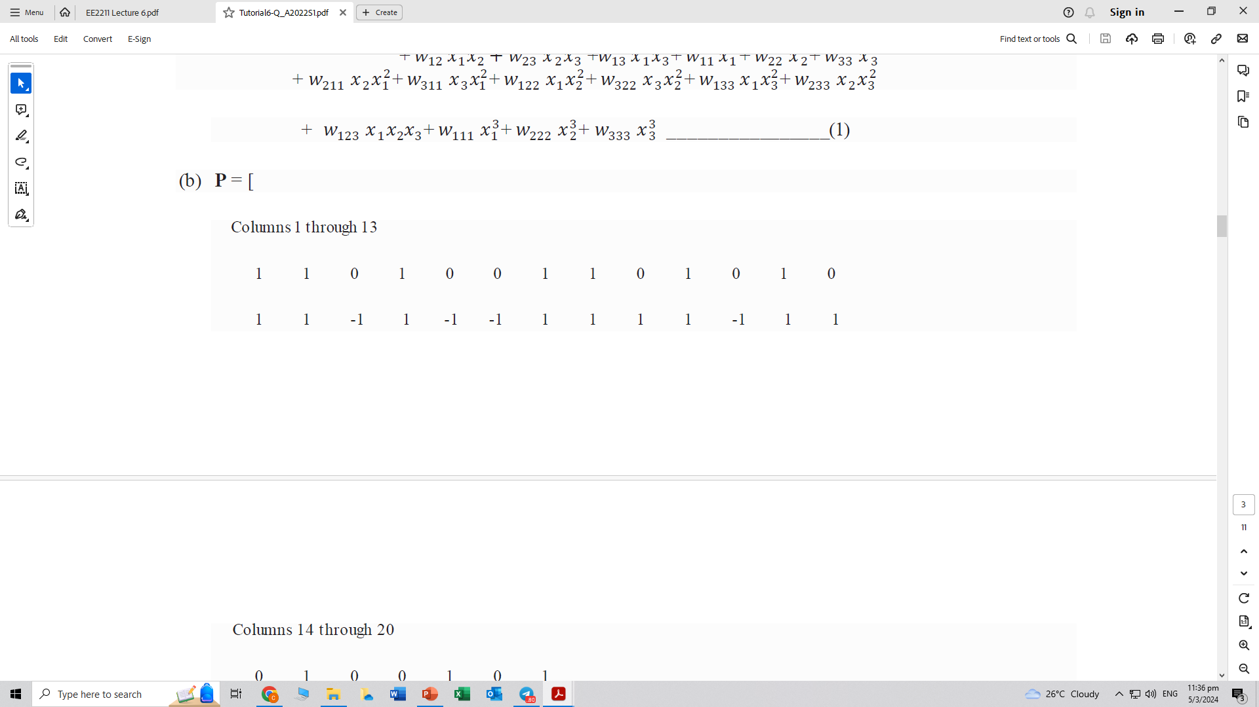
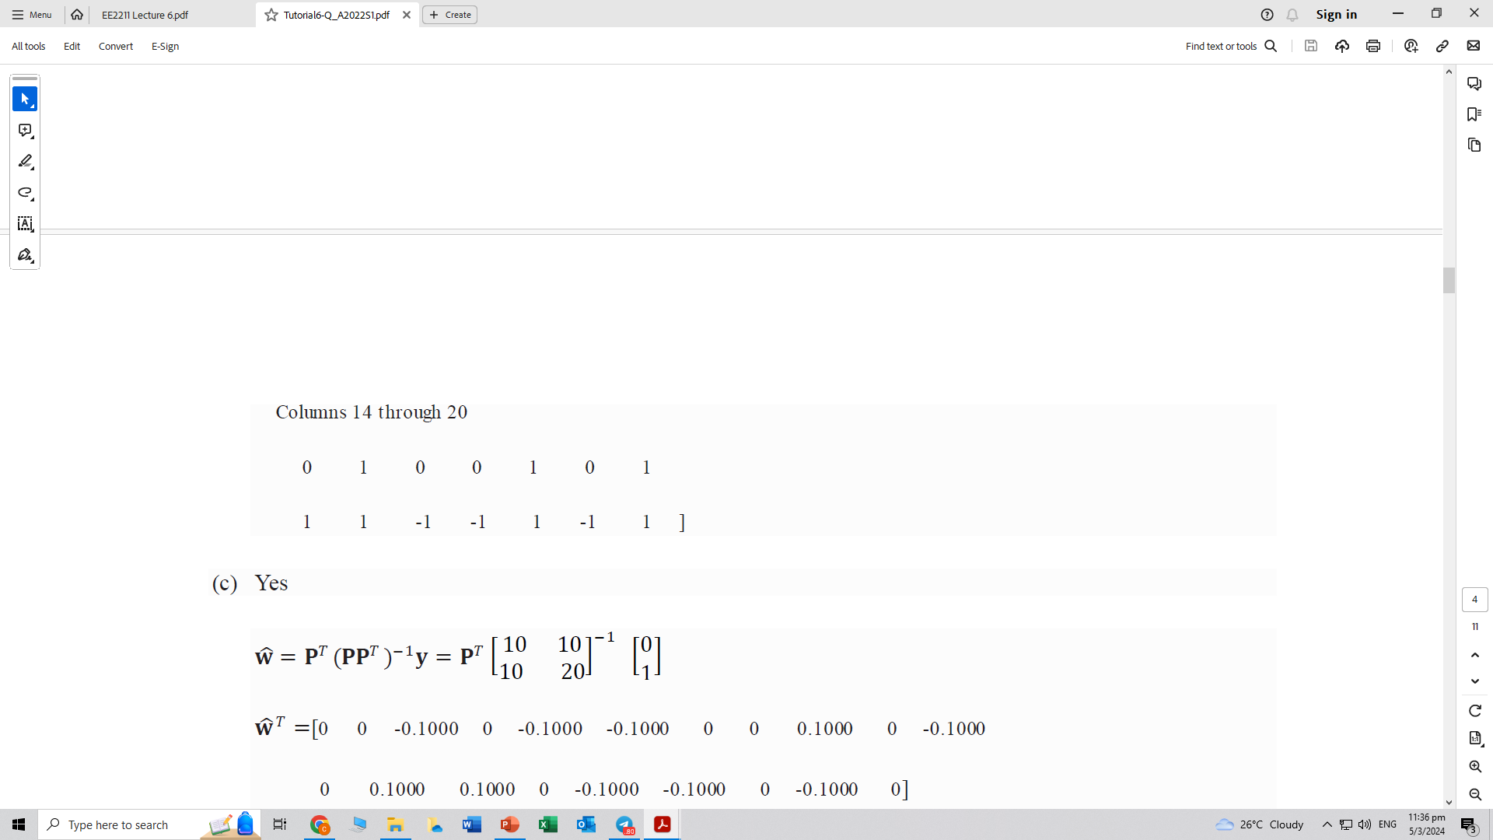
Question 3
Write down the P matrix for this polynomial given
$X=\left[\begin{matrix}x_{11} & x_{12} & x_{13} \\ x_{21} & x_{22} & x_{23}\end{matrix}\right]=\left[\begin{matrix}1 & 0 & 1 \\ 1 & −1 & 1\end{matrix}\right]$

Slide 22
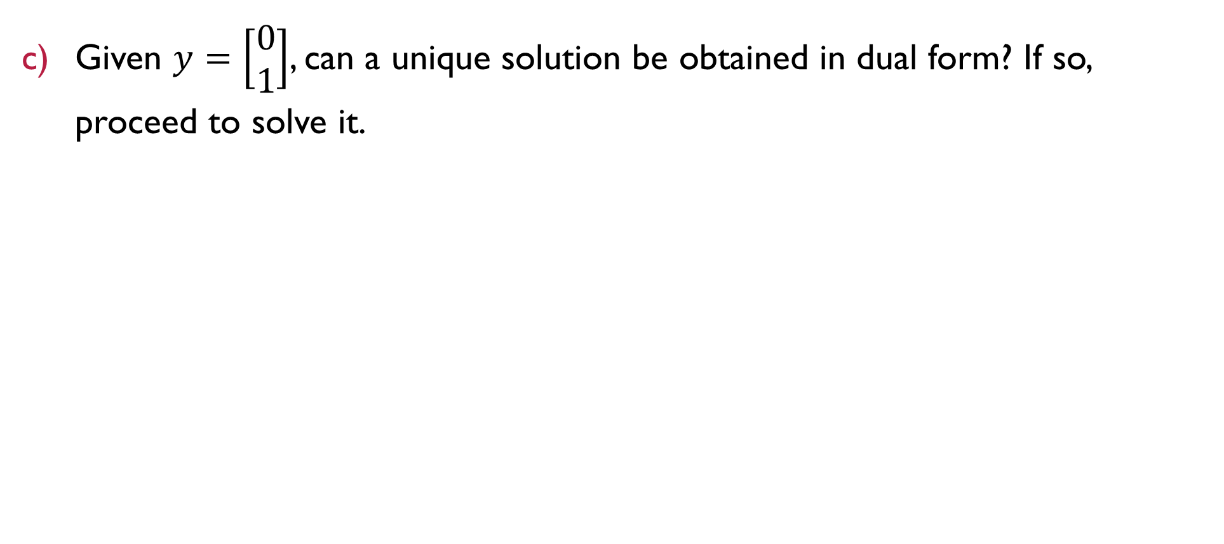
Question 3
Given $y=\left[\begin{matrix}0 \\ 1\end{matrix}\right]$, can a unique solution be obtained in dual form? If so, proceed to solve it.

Slide 23
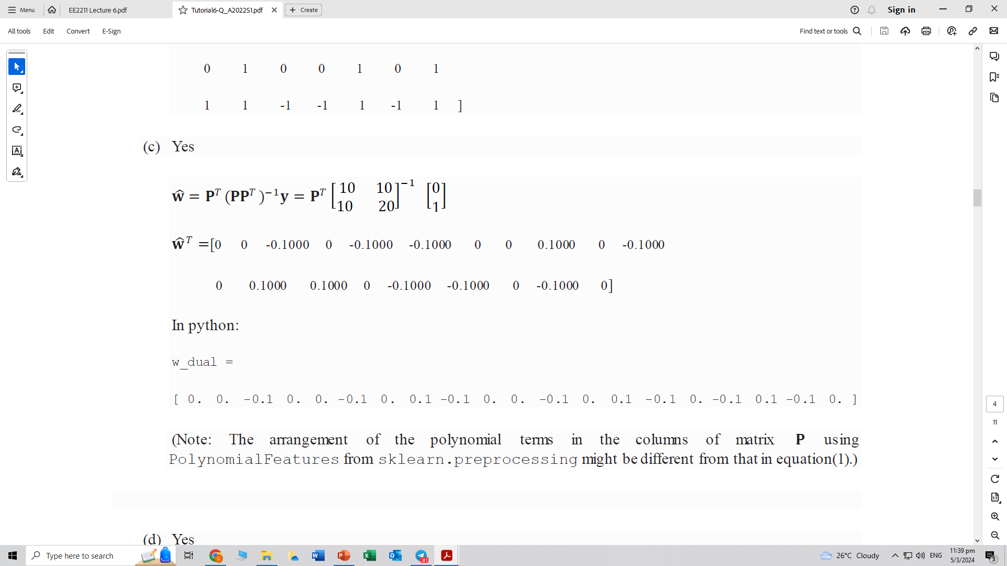
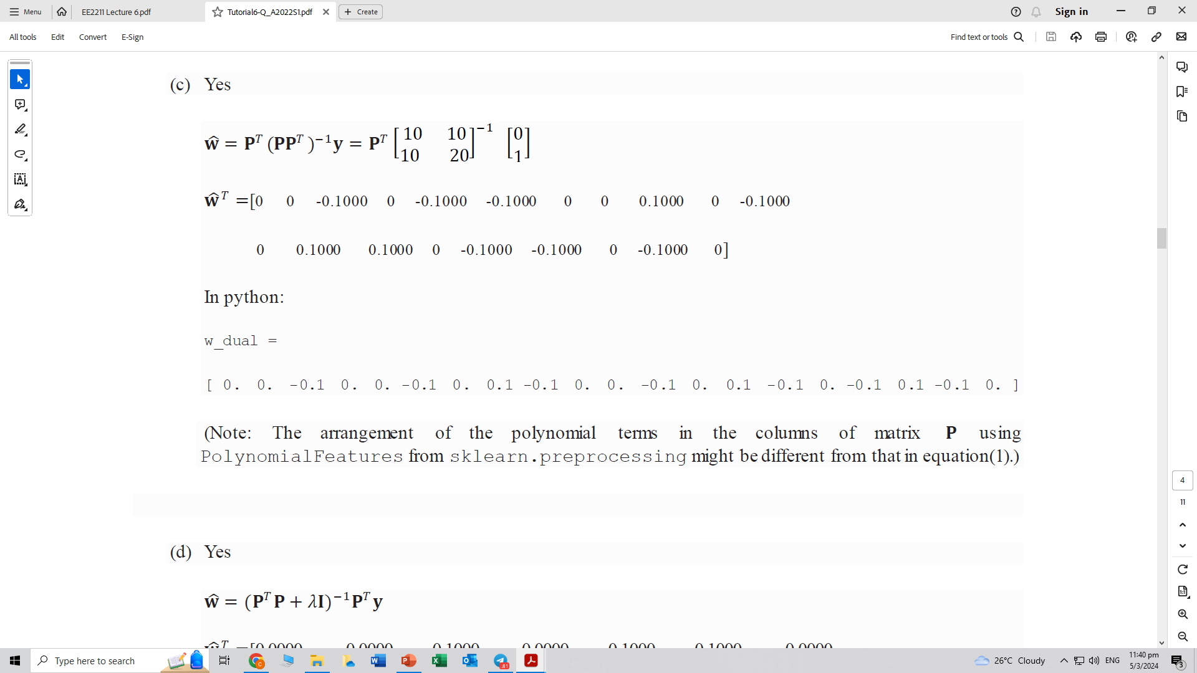
Question 3
Given $y=\left[\begin{matrix}0 \\ 1\end{matrix}\right]$, can a unique solution be obtained in dual form? If so, proceed to solve it.

Slide 24
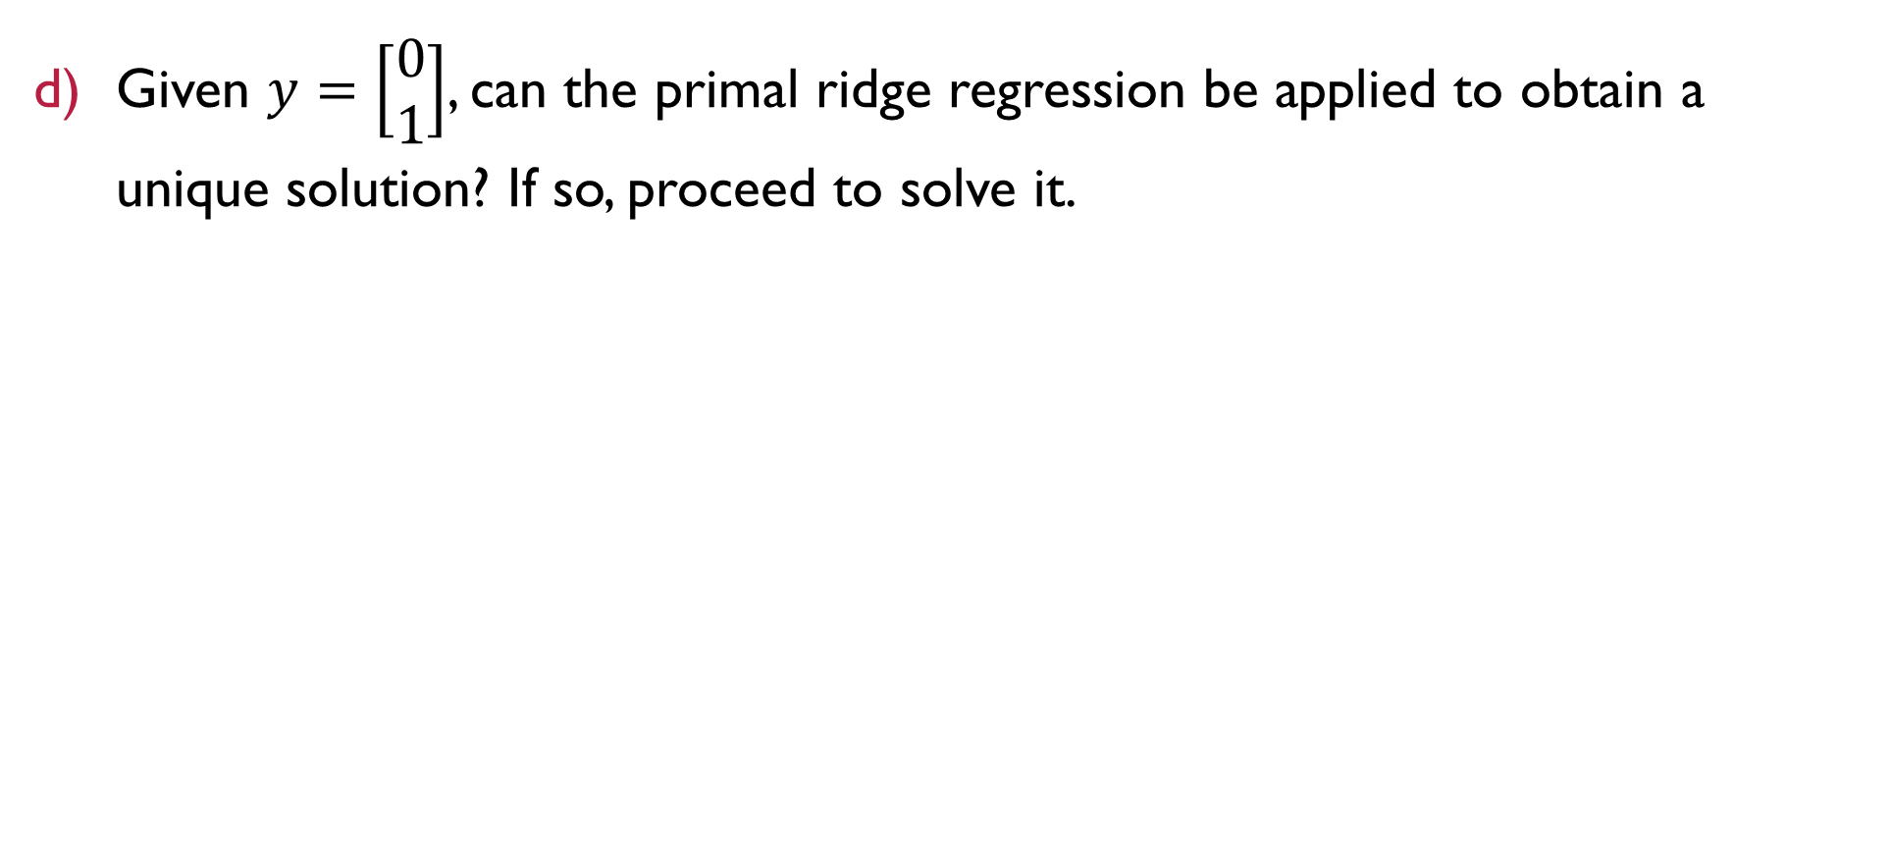
Question 3
Given $y=\left[\begin{matrix}0 \\ 1\end{matrix}\right]$, can the primal ridge regression be applied to obtain a unique solution? If so, proceed to solve it.

Slide 25
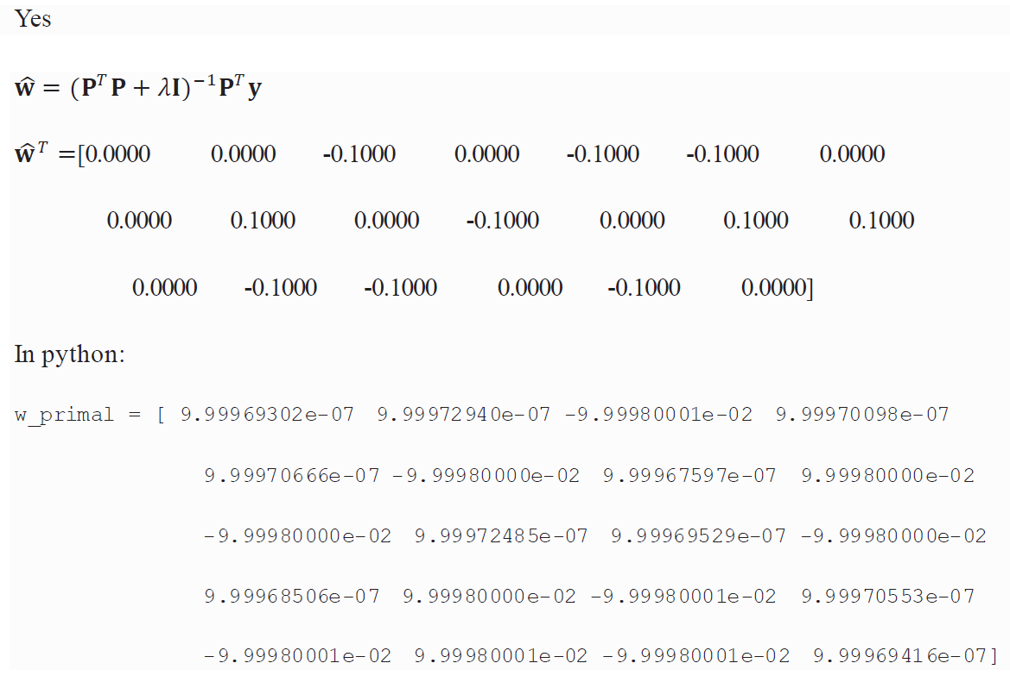
Question 3
Given $y=\left[\begin{matrix}0 \\ 1\end{matrix}\right]$, can the primal ridge regression be applied to obtain a unique solution? If so, proceed to solve it.

Slide 26
Question 3
Given $y=\left[\begin{matrix}0 \\ 1\end{matrix}\right]$, can the primal ridge regression be applied to obtain a unique solution? If so, proceed to solve it.
Here, at 𝜆=0.0001,we observe a very close solution to that in (c) even though (d) constitutes an approximation whereas (c) is exact.

Slide 27
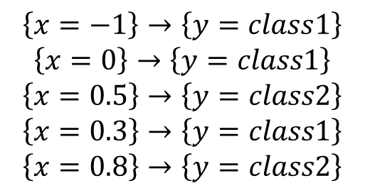
Question 4
Given the training data, predict the class label for {𝑥=−0.1} and {𝑥=0.4} using linear regression with signum discrimination
$$\left\{x=−1\right\}→\left\{y=class1\right\}$$
$$\left\{x=0\right\}→\left\{y=class1\right\}$$
$$\left\{x=0.5\right\}→\left\{y=class2\right\}$$
$$\left\{x=0.3\right\}→\left\{y=class1\right\}$$
$$\left\{x=0.8\right\}→\left\{y=class2\right\}$$

Slide 28
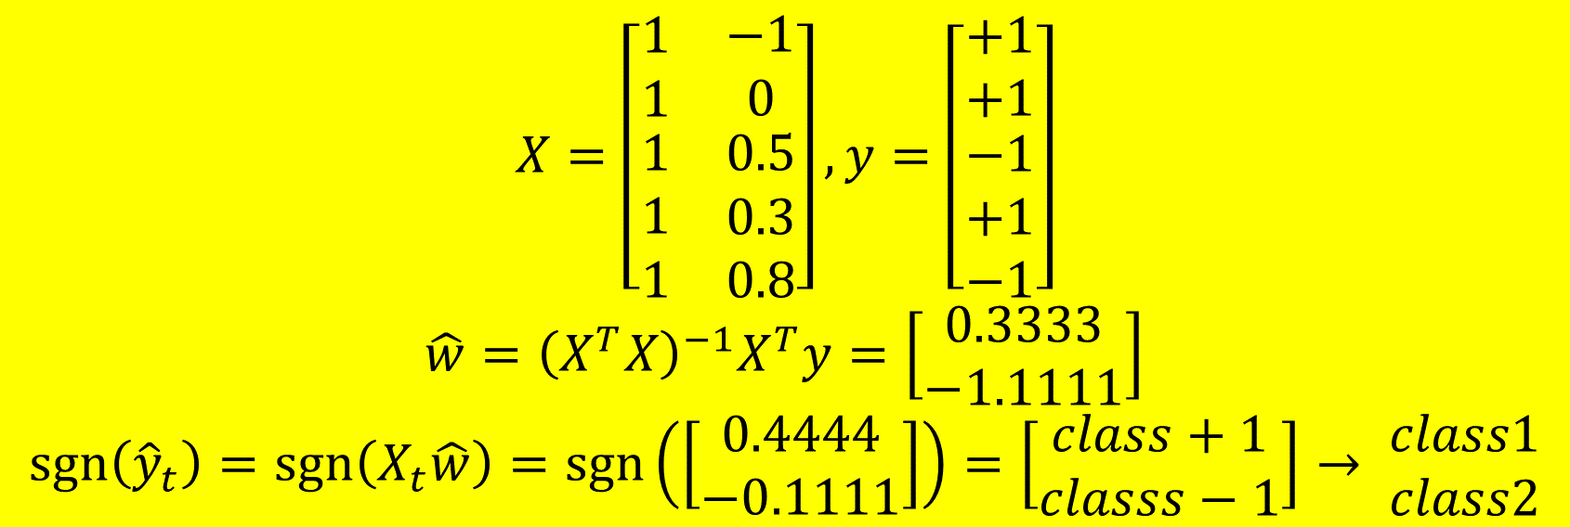
Question 4
Given the training data, predict the class label for {𝑥=−0.1} and {𝑥=0.4} using linear regression with signum discrimination
$$\left\{x=−1\right\}→\left\{y=class1\right\}$$
$$\left\{x=0\right\}→\left\{y=class1\right\}$$
$$\left\{x=0.5\right\}→\left\{y=class2\right\}$$
$$\left\{x=0.3\right\}→\left\{y=class1\right\}$$
$$\left\{x=0.8\right\}→\left\{y=class2\right\}$$
$$X=\left[\begin{matrix}\begin{matrix}1 \\ 1 \\ \begin{matrix}1 \\ 1 \\ 1\end{matrix}\end{matrix} & \begin{matrix}−1 \\ 0 \\ \begin{matrix}0.5 \\ 0.3 \\ 0.8\end{matrix}\end{matrix}\end{matrix}\right],y=\left[\begin{matrix}+1 \\ +1 \\ \begin{matrix}−1 \\ +1 \\ −1\end{matrix}\end{matrix}\right]$$
$$\hat{w}={\left(X^{T}X\right)}^{−1}X^{T}y=\left[\begin{matrix}0.3333 \\ −1.1111\end{matrix}\right]$$
$$\operatorname{sgn}\left({\hat{y}}_{t}\right)=\operatorname{sgn}\left(X_{t}\hat{w}\right)=\operatorname{sgn}\left(\left[\begin{matrix}0.4444 \\ −0.1111\end{matrix}\right]\right)=\left[\begin{matrix}class+1 \\ classs−1\end{matrix}\right]→ \begin{matrix}class1 \\ class2\end{matrix}$$

Slide 29
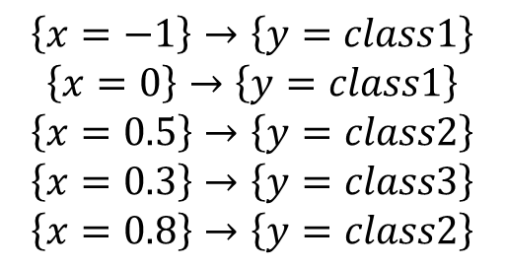
Question 5
Given the training data
Predict the class label for {𝑥=−0.1} and {𝑥=0.4} based on linear regression towards a one-hot encoded target.
Predict the class label for {𝑥=−0.1} and {𝑥=0.4} using a polynomial model of 5th order and a one-hot encoded target
$$\left\{x=−1\right\}→\left\{y=class1\right\}$$
$$\left\{x=0\right\}→\left\{y=class1\right\}$$
$$\left\{x=0.5\right\}→\left\{y=class2\right\}$$
$$\left\{x=0.3\right\}→\left\{y=class3\right\}$$
$$\left\{x=0.8\right\}→\left\{y=class2\right\}$$

Slide 30
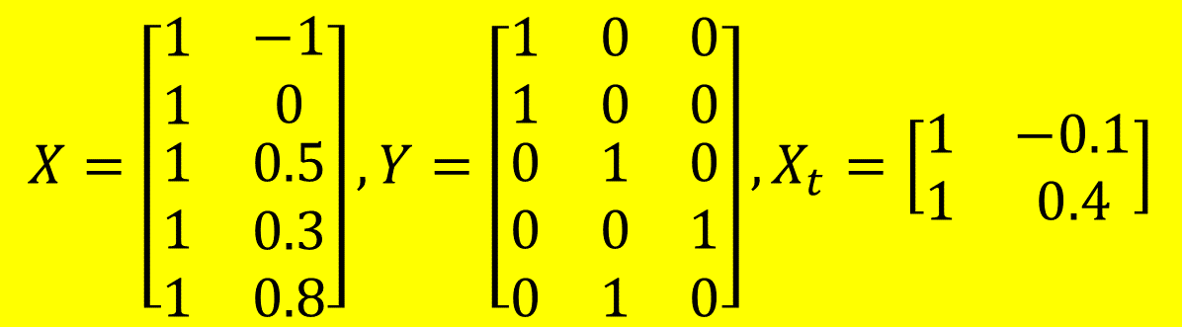
Question 5
Given the training data
Predict the class label for {𝑥=−0.1} and {𝑥=0.4} based on linear regression towards a one-hot encoded target.
Predict the class label for {𝑥=−0.1} and {𝑥=0.4} using a polynomial model of 5th order and a one-hot encoded target.
$$\left\{x=−1\right\}→\left\{y=class1\right\}$$
$$\left\{x=0\right\}→\left\{y=class1\right\}$$
$$\left\{x=0.5\right\}→\left\{y=class2\right\}$$
$$\left\{x=0.3\right\}→\left\{y=class3\right\}$$
$$\left\{x=0.8\right\}→\left\{y=class2\right\}$$
$$X=\left[\begin{matrix}\begin{matrix}1 \\ 1 \\ \begin{matrix}1 \\ 1 \\ 1\end{matrix}\end{matrix} & \begin{matrix}−1 \\ 0 \\ \begin{matrix}0.5 \\ 0.3 \\ 0.8\end{matrix}\end{matrix}\end{matrix}\right],Y=\left[\begin{matrix}\begin{matrix}1 & 0 & 0\end{matrix} \\ \begin{matrix}1 & 0 & 0\end{matrix} \\ \begin{matrix}\begin{matrix}0 & 1 & 0\end{matrix} \\ \begin{matrix}0 & 0 & 1\end{matrix} \\ \begin{matrix}0 & 1 & 0\end{matrix}\end{matrix}\end{matrix}\right],X_{t}=\left[\begin{matrix}1 & −0.1 \\ 1 & 0.4\end{matrix}\right]$$

Slide 31
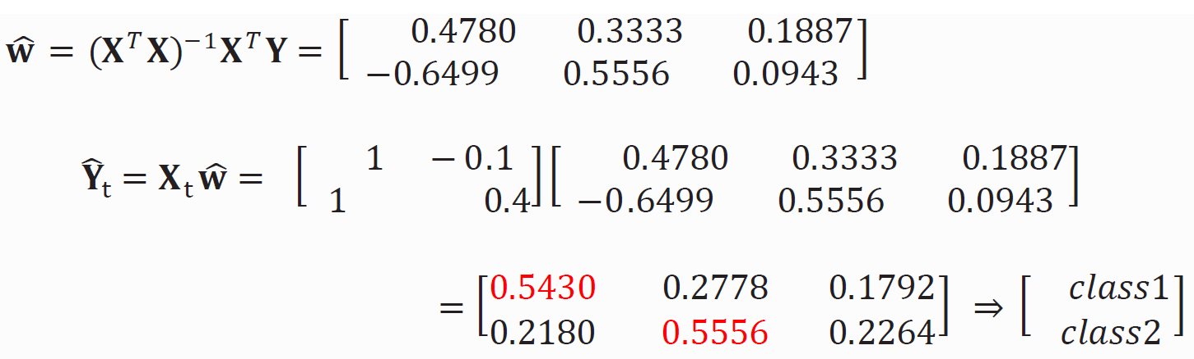
Question 5
Given the training data
Predict the class label for {𝑥=−0.1} and {𝑥=0.4} based on linear regression towards a one-hot encoded target.

Slide 32
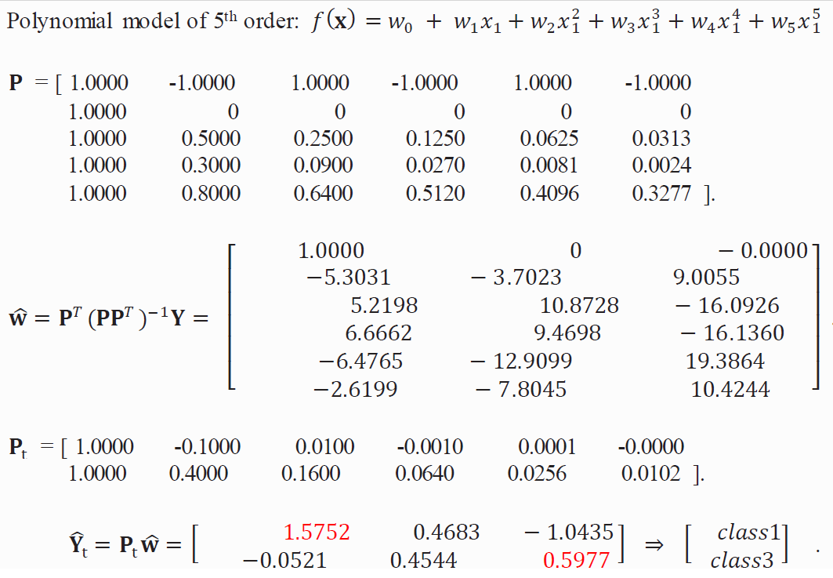
Question 5
Given the training data
Predict the class label for {𝑥=−0.1} and {𝑥=0.4} using a polynomial model of 5th order and a one-hot encoded target.

Slide 33
Question 6 (python)
Get the data set “from sklearn.datasets import load_iris”. Use Python to perform the following tasks:
Split the database into two sets: 74% of samples for training, and 26% of samples for testing
Construct the target output using one-hot encoding
Perform a linear regression for classification (without inclusion of ridge, utilizing one-hot encoding for the learning target) and compute the number of test samples that are classified correctly
Using the same training and test sets as in above, perform a 2nd order polynomial regression for classification (again, without inclusion of ridge, utilizing one-hot encoding for the learning target) and compute the number of test samples that are classified correctly

Slide 34
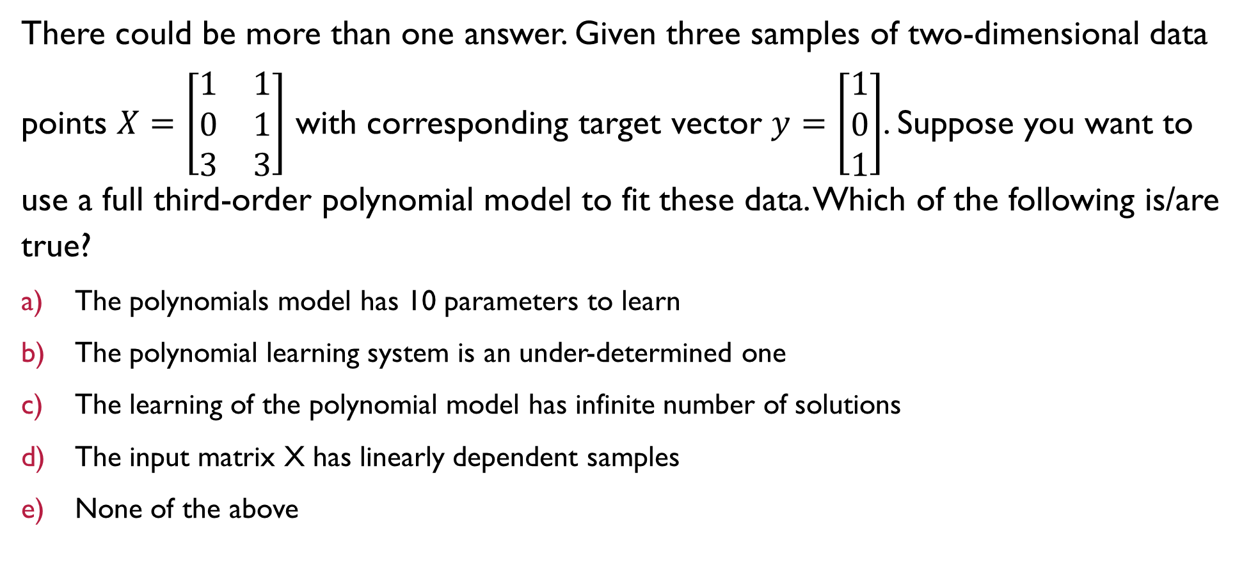
Question 7
There could be more than one answer. Given three samples of two-dimensional data points $X=\left[\begin{matrix}1 & 1 \\ 0 & 1 \\ 3 & 3\end{matrix}\right]$ with corresponding target vector $y=\left[\begin{matrix}1 \\ 0 \\ 1\end{matrix}\right]$. Suppose you want to use a full third-order polynomial model to fit these data. Which of the following is/are true?
The polynomials model has 10 parameters to learn
The polynomial learning system is an under-determined one
The learning of the polynomial model has infinite number of solutions
The input matrix X has linearly dependent samples
None of the above

Slide 35
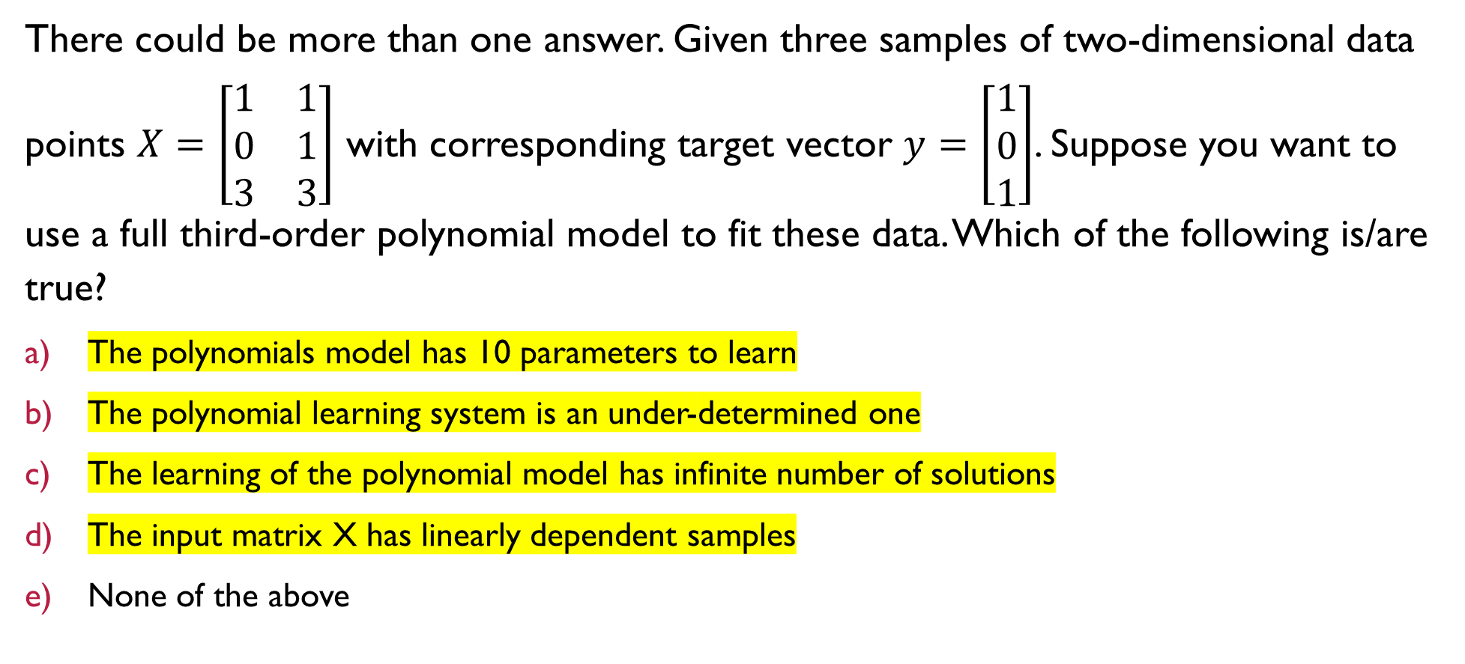
Question 7
There could be more than one answer. Given three samples of two-dimensional data points $X=\left[\begin{matrix}1 & 1 \\ 0 & 1 \\ 3 & 3\end{matrix}\right]$ with corresponding target vector $y=\left[\begin{matrix}1 \\ 0 \\ 1\end{matrix}\right]$. Suppose you want to use a full third-order polynomial model to fit these data. Which of the following is/are true?
The polynomials model has 10 parameters to learn
The polynomial learning system is an under-determined one
The learning of the polynomial model has infinite number of solutions
The input matrix X has linearly dependent samples
None of the above

Slide 36
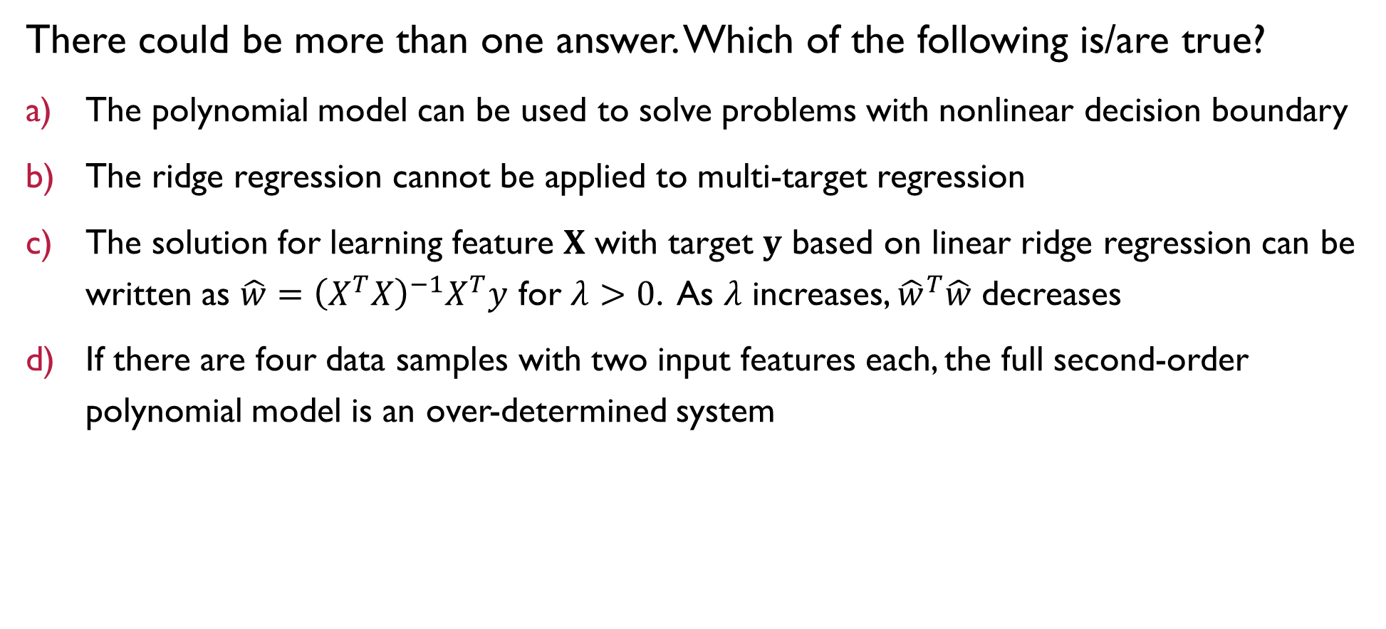
Question 8
There could be more than one answer. Which of the following is/are true?
The polynomial model can be used to solve problems with nonlinear decision boundary
The ridge regression cannot be applied to multi-target regression
The solution for learning feature 𝐗 with target 𝐲 based on linear ridge regression can be written as $\hat{w}={\left(X^{T}X\right)}^{−1}X^{T}y$ for $λ>0$. As 𝜆 increases, ${\hat{w}}^{T}\hat{w}$ decreases
If there are four data samples with two input features each, the full second-order polynomial model is an over-determined system

Slide 37
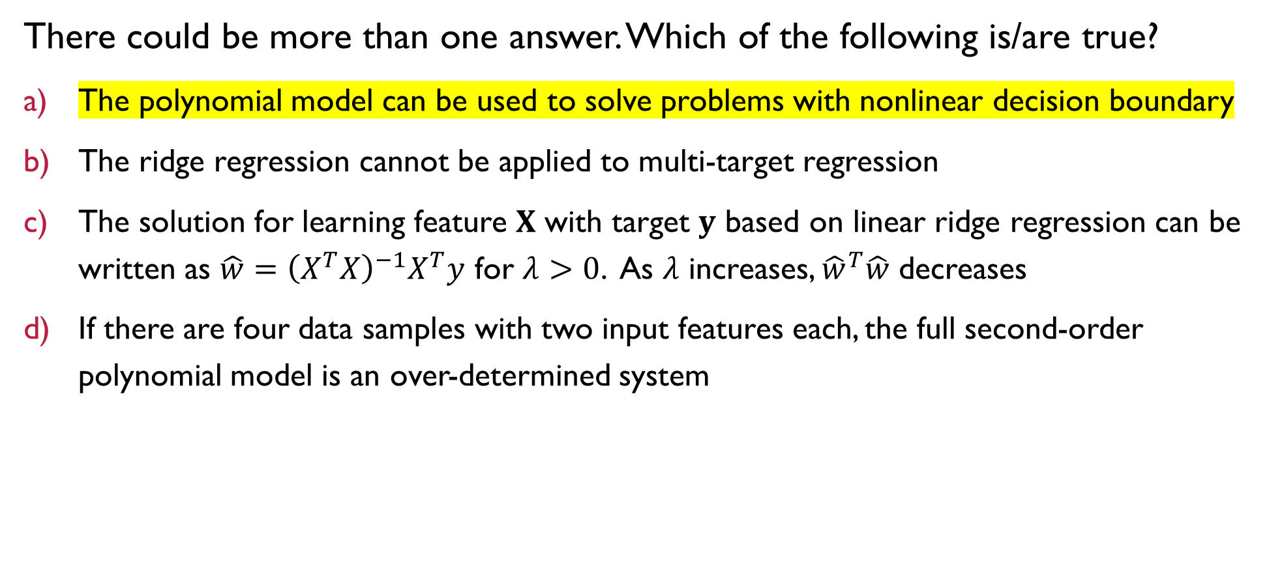
Question 8
There could be more than one answer. Which of the following is/are true?
The polynomial model can be used to solve problems with nonlinear decision boundary
The ridge regression cannot be applied to multi-target regression
The solution for learning feature 𝐗 with target 𝐲 based on linear ridge regression can be written as $\hat{w}={\left(X^{T}X\right)}^{−1}X^{T}y$ for $λ>0$. As 𝜆 increases, ${\hat{w}}^{T}\hat{w}$ decreases
If there are four data samples with two input features each, the full second-order polynomial model is an over-determined system

Slide 38


Questions?
Feel free to come up to me if you have any questions about anything!
If you are shy, you can use the anonymous form to leave questions & feedback about the tutorial.
You can also reach out to me on our Telegram group or PM me at @eehongchan
Anonymous feedback
Telegram
https://forms.gle/c9QU94YcWjR3EZFk9

